Slide 1
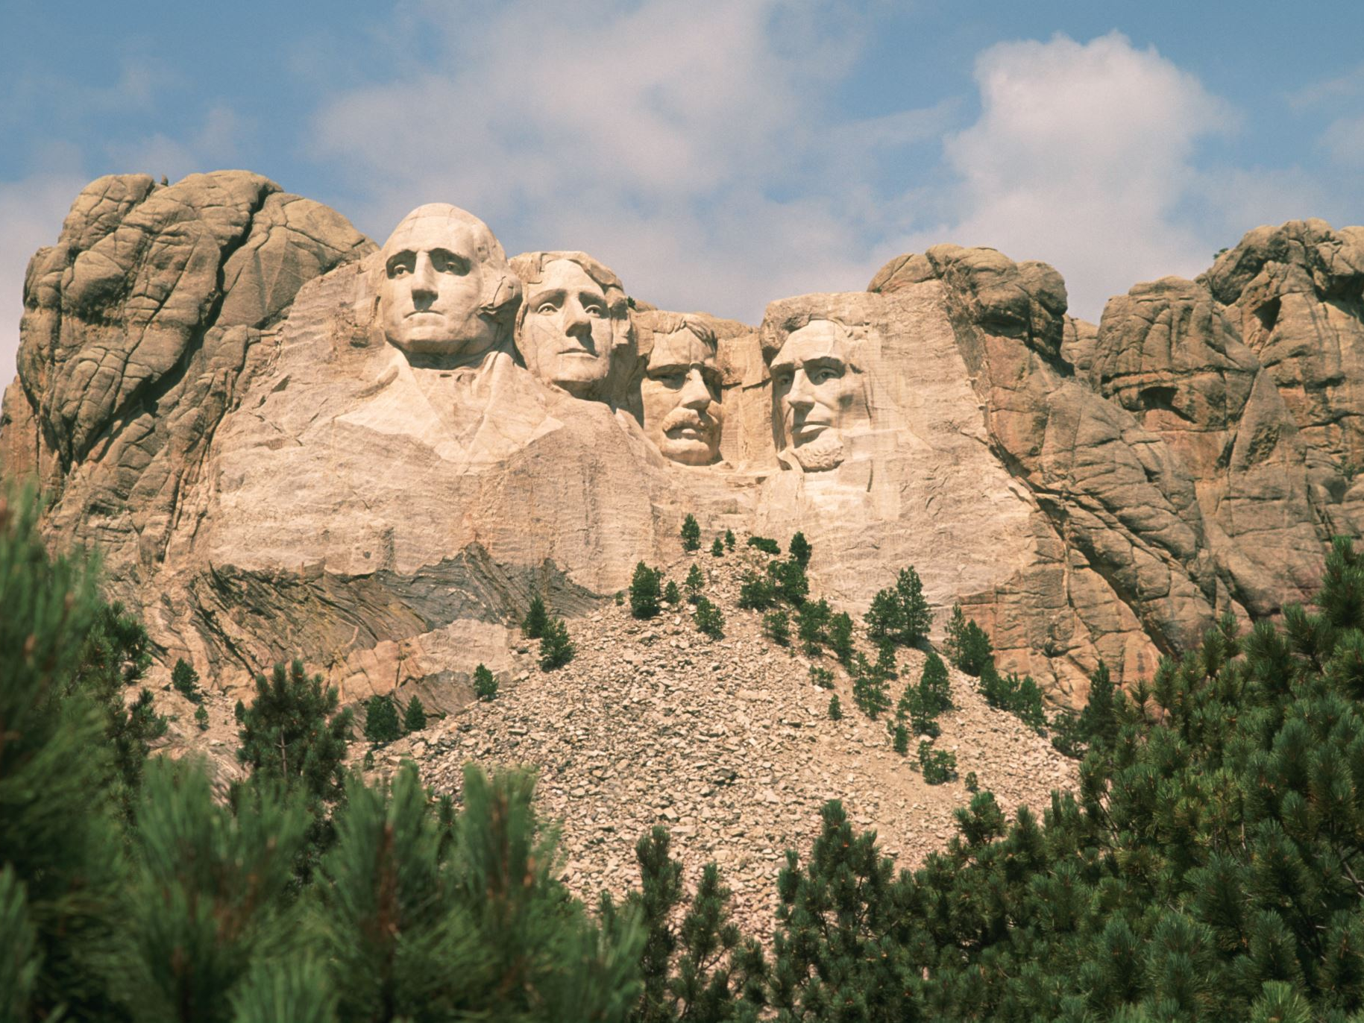
Optimizing Revenue Streams:
Leveraging Neural Networks in Market-driven E-commerce
PRESENTED BY :
SRUTHI BAGAM
PRIYA BANDHAVI SUKKA
PRAVEEN KUMAR BODDUPALLI
NAVEEN MALOTHU

Slide 2

Motivation
The motivation behind employing market-based e-commerce analysis with deep learning on neural networks lies in its potential to extract valuable insights from large volumes of online sales data. Here's why it's compelling:
1. *Identifying Trends:* By analyzing online sales data, businesses can uncover trends and patterns that may not be immediately apparent. This can include seasonal fluctuations, emerging product preferences, or changes in consumer behavior.
2. *Optimizing Product Selection:* Understanding which products are highly sold in the market allows businesses to optimize their product selection and inventory management strategies. This can lead to more efficient use of resources and higher profitability.
3. *Personalized Recommendations:* Deep learning models can be trained to provide personalized product recommendations to customers based on their past purchasing behavior and preferences. This can enhance the shopping experience and increase customer satisfaction and loyalty.

Slide 3
OBJECTIVE
The objective of the market-based e-commerce analysis with machine learning is to utilize deep learning algorithms to identify the top-selling products in the online market. This involves the following key objectives:
1. *Data Collection:* Gather a comprehensive dataset containing online sales data, including product information, sales volumes, and other relevant features.
2. *Pre-processing:* Cleanse the dataset by removing noisy and null value data to ensure the quality and reliability of the input data for analysis.
3. *Analysis and Visualization:* Conduct exploratory data analysis to gain insights into the sales patterns and trends. Visualize the data to facilitate better understanding and interpretation of the underlying patterns.
4. *Deep Learning Application:* Employ deep learning neural network algorithms to predict the highest sales of groups of products. This involves training the model on historical sales data to learn patterns and relationships between various features.
5. *Evaluation and Deployment:* Evaluate the performance of the deep learning model using appropriate metrics and techniques. Once satisfactory performance is achieved, deploy the model in e-commerce online sales web applications to assist in identifying the highest-selling products..

Slide 4
PROBLEM STATEMENT
- Identifying top utility items for high profits in online applications is challenging due to the increasing dataset sizes.
- User ratings and opinions vary across different product varieties, complicating predictions.
- Predicting the most needed product accurately in market strategy analysis is difficult.
- Accuracy in identifying items in large datasets is also challenging.

Slide 5
LIMITATION OF EXISTING SYSTEM
1. *Scalability:* As the dataset grows, the computational resources required for analysis increase, making it challenging to efficiently process and identify high-profit items.
2. *Subjectivity:* User ratings and opinions on products can vary widely, making it difficult to accurately predict which products will yield the highest utility for different users
.3. *Prediction Accuracy:* Exact prediction of the most needed product in the market is challenging due to the dynamic nature of consumer preferences and market trends. It's difficult to predict with certainty which products will be in high demand at any given time.
4. *Accuracy in Large Datasets:* As the dataset size increases, maintaining accuracy in identifying high-profit items becomes more difficult. The sheer volume of data can lead to increased noise and complexities in analysis, impacting the accuracy of predictions.

Slide 6
PROPOSED system
1. *Improved Accuracy:* By employing deep learning techniques, such as CNNs, the accuracy of identifying profitable products is expected to increase. CNNs are known for their ability to extract intricate patterns and features from data, which can lead to more precise predictions.
2. *Deep Learning Advantage:* Deep learning on neural networks provides a robust solution for addressing the challenge of identifying profitable products in real-world data. Neural networks can handle complex relationships within the data, allowing for more nuanced analysis compared to traditional methods.
3. *Convolutional Neural Networks (CNNs):* CNNs are particularly well-suited for analyzing visual data, such as images or graphical representations of datasets. By training and testing the data using CNN algorithms, the system can efficiently process and analyze large datasets, leading to more accurate insights.

Slide 7

ADVANTAGES OF PROPOSED SYSTEM
HIGH Performance
Good Accuracy level.
Increase in profit ratio
Can predict the top level selling items in market

Slide 8
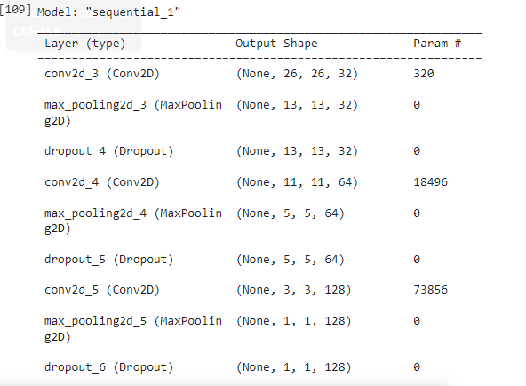
Experimental results
The Convolutional Neural Networks algorithm is applied with creating the sequential model. The output of the sequential model with layers is displayed.

Slide 9
CONCLUSION
The convolutional neural network calculations are applied to figure out the top high utility item things from the amazon dataset.
Future work in this field can include, a distributed and dynamic method. It generates complete set of high utility item sets from large databases.
Mining high utility item sets from databases refers to finding the item sets with high profit

Slide 10
REFERENCE
[1] T. Hamrouni, S. Yahia, and E. M. Nguifo, “Sweeping the disjunctive search space towards mining new exact concise representations of frequent item sets ,” Data Knowl. Eng., vol. 68, no. 10, pp. 1091–1111, 2009.
[2] B.-E. Shie, H.-F. Hsiao, V. S. Tseng, and P. S. Yu, “Mining high utility mobile sequential patterns in mobile commerce environments,” in Proc. Int. Conf. Database Syst. Adv. Appl., 2011, vol. 6587, pp. 224–238..
[3] Y.Liu, W.K. Liao and A. Choudhary, ―A two phase algorithm for fast discovery of high utility itemset‖, Cheng, D. and Liu. H. PAKDD, LNCS. PP: 689-695, 2005.
[4] J.Hu, A. Mojsilovic, ―High utility pattern mining: A method for discovery of high utility itemssets‖, in: pattern recognition. PP: 3317-3324, 2007.
[5] Y.-C. Li,j,-s. Yeh, and C.-C. Chang, ―Isolated Items Discarding Strategy for Discovering High Utility Item sets ,‖ Data and Knowledge engg., pp: 198-217, 2008.

Slide 11
REFERENCE
[7] Liu Jian-Ping, Wang Ying Fan-Ding, ‖UP- Growth Mining algorithm Pre-FP in Association Rule Based on FP-tree‖, Networking and Distributed Computing, International Conference, pp: 199-203, 2010.
[8] Ahmed CF,Tanbeer SK,Jeong B-S, Lee Y-K (2011) ―HUC-Prune: An Efficient Candidate Pruning Technique to mine high utility patterns‖ Appl Intell PP: 181–198, 2011.
[9] Shih-Sheng Chen, Tony Cheng-Kui Huang, Zhe-Min Lin, ―New and efficient knowledge discovery of partial periodic patterns with multiple minimum supports‖, The Journal of Systems and Software 84, pp. 1638–1651, 2011, ELSEVIER.
[10] Chowdhury Farhan Ahmed, Syed Khairuzzaman Tanbeer, Byeong-Soo Jeong, Young-Koo Lee a,Ho-Jin Choi(2012) ―Single-pass UP- Growth and interactive mining for weighted frequent patterns‖, Expert Systems with Applications 39 pp.7976– 7994, ELSEVIER 2012.

Slide 12
THANk YOU !!!

